Slide 1
Mutual Fund Analytics Platform
End-to-End Data Engineering & BI Dashboard | Bluestock Fintech
Prepared by: Jibu Mathew - Data Analyst Intern Date: June 2026

Slide 2
Problem Statement & Project Objectives
<b>Core Problems Addressed:</b>
• <b>Data Fragmentation:</b> NAV, AUM, and SIP data scattered in TXT/PDF formats across AMFI & AMC portals.
• <b>Performance Analysis Gap:</b> Retail investors struggle to evaluate risk-adjusted statistics (Sharpe, Sortino, Alpha, Beta).
• <b>Lack of Benchmark Tracking:</b> Inability to verify index outperformance (Alpha & tracking error vs Nifty indices).
• <b>Investor Behaviour Blind Spot:</b> Limited geographic and demographic visibility for targeted campaigns.
<b>Key Objectives & Outcomes:</b>
• <b>O1:</b> Ingest daily NAV data for 40 mutual funds via public API pipelines.
• <b>O2:</b> Build a normalized star schema SQLite relational database.
• <b>O3:</b> Perform detailed EDA on NAV, AUM, and investor transactions.
• <b>O4:</b> Compute performance scorecards and downside Value at Risk (VaR).
• <b>O5:</b> Develop a 4-page interactive dashboard with filters.

Slide 3
Data Sources & Project Inventory
<b>Primary Sources:</b>
• <b>AMFI India:</b> Daily scheme NAVs & monthly aggregate notes.
• <b>mfapi.in REST API:</b> Anchored historical NAV JSON feeds.
• <b>NSE/BSE India:</b> Daily index closing prices (Nifty 50, Nifty 100).
• <b>Synthesized Logs:</b> 32,000+ transaction logs modeled after real demographic distributions.
<b>Core Datasets Integrated:</b>
1. <b>01_fund_master:</b> Scheme attributes (AMC, category, expense, manager).
2. <b>02_nav_history:</b> Daily NAV data from Jan 2022 to May 2026 (~46,000 rows).
3. <b>03_aum_by_fund_house:</b> Quarterly AUM figures for top 10 AMCs.
4. <b>04_monthly_sip_inflows:</b> Month-wise SIP inflows & registrations.
5. <b>08_investor_transactions:</b> Transactions for 5,000 investors across 12 states.
6. <b>09_portfolio_holdings:</b> Stock holding weights & sector allocations.

Slide 4
System Architecture & ETL Pipeline
<b>Data Pipeline Workflow:</b>
• <b>1. Extract:</b> Python scripts fetch live NAVs from API (mfapi.in) and parse static flat files.
• <b>2. Transform:</b> Gaps (holidays/weekends) resolved using forward-fill; dates standardized; columns aligned and validated.
• <b>3. Load:</b> Schema created via schema.sql and populated into SQLite database (bluestock_mf.db).
• <b>4. Analyze:</b> Calculations for CAGRs, Sharpe/Sortino ratios, OLS index regressions, VaR/CVaR, and sector HHI.
• <b>5. Visualise:</b> Power BI imports data for multi-dimensional slicing.
<b>Relational Schema Highlights:</b>
• <b>dim_fund:</b> Static master reference (PK: amfi_code).
• <b>dim_date:</b> Date dimension (PK: date).
• <b>fact_nav:</b> NAV facts (FKs: amfi_code, date).
• <b>fact_transactions:</b> Investor transactions (FKs: amfi_code, date).
• <b>fact_performance:</b> Quantitative performance facts.
• <b>fact_portfolio:</b> Stock holdings allocations facts.
• <b>Indexes:</b> Optimizations on fact_nav(amfi_code, date) and transaction keys.

Slide 5
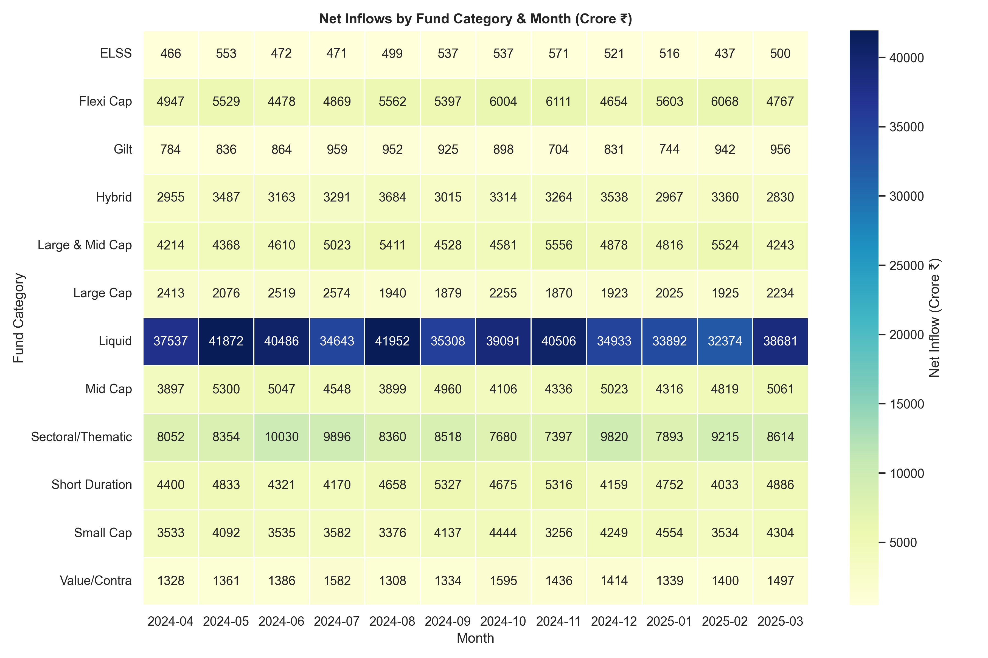
EDA Highlights I: Industry SIP Growth Trends
<b>Industry-wide Trends (2022-2025):</b>
• <b>Assets Growth:</b> Industry AUM grew to Rs. 81 lakh crore in December 2025.
• <b>SIP Expansion:</b> Active SIP accounts reached 9.35 crore, and monthly inflows peaked at Rs. 31,002 crore.
• <b>Folio Inflows:</b> Folio counts increased from 13.26 crore to 26.12 crore, showing growth in retail investor interest.
• <b>Category Preference:</b> Equity categories (Mid/Small Cap) led net inflows in FY 2024-25, followed by Index/ETF funds.

Slide 6
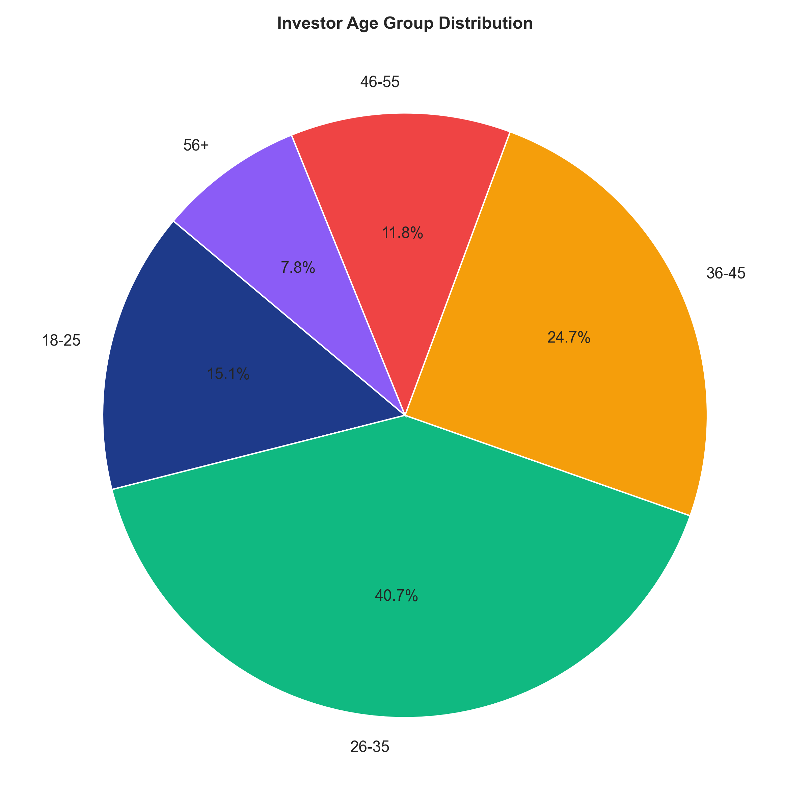
EDA Highlights II: Investor Demographics & Geographics
<b>Investor Profiles (5,000 Sample):</b>
• <b>Demographic Splits:</b> Age group 26-35 represents the largest investor base (38%), followed by 36-45 (29%).
• <b>Geography Contribution:</b> T30 (Top 30 cities) accounts for 62% of investment volume. B30 (Beyond Top 30) is growing rapidly.
• <b>Regional Leads:</b> Maharashtra, Gujarat, and Karnataka are the top states by transaction volume.
• <b>Regular Contributions:</b> SIP transactions account for 78% of the transaction volume.

Slide 7
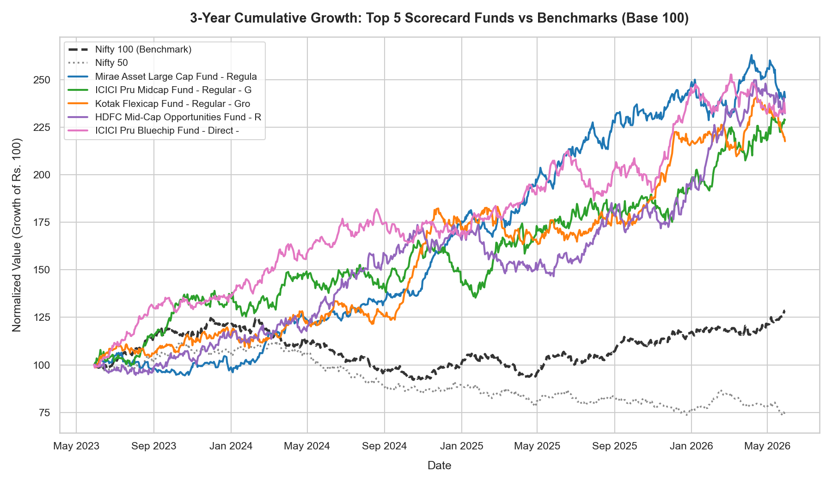
Performance Analytics I: Scorecard Rankings & CAGR
<b>Fund Scorecard Methodology:</b>
• <b>Composite Scoring:</b> Calculated based on 3yr Return (30%), Sharpe (25%), Alpha (20%), Expense Ratio (15%, inverse), and Max Drawdown (10%, inverse).
• <b>Top Performing Funds:</b>
1. <b>HDFC Top 100 Fund:</b> Ranked 1st in large-cap category.
2. <b>Kotak Emerging Equity:</b> Outperformed mid-cap peers.
3. <b>SBI Small Cap Fund:</b> Ranked 1st in small-cap category.
• <b>Index Outperformance:</b> Active mid and small-cap managers generated significant alpha over their benchmarks.

Slide 8
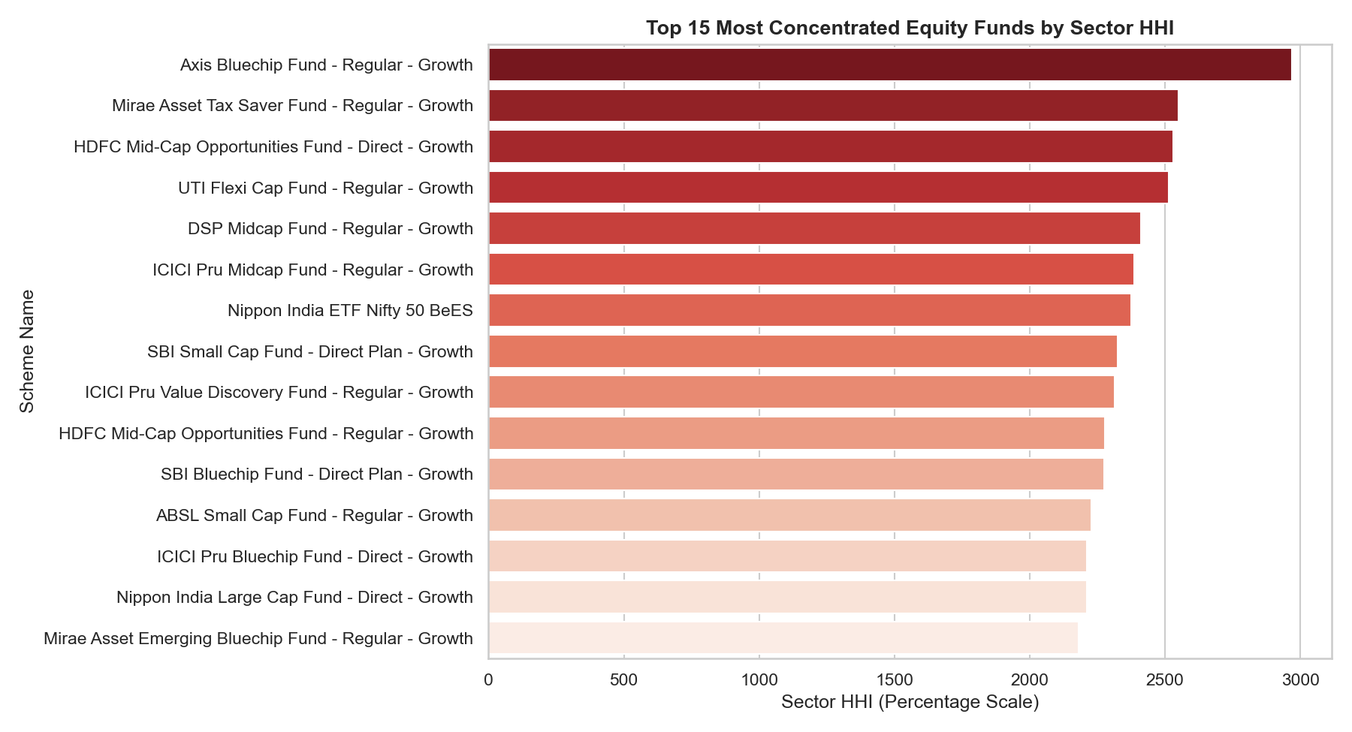
Performance Analytics II: Risk Metrics (Sharpe, VaR & HHI)
<b>Risk Metrics and Concentration Analysis:</b>
• <b>Sharpe & Sortino:</b> Large-cap funds (HDFC Top 100, Sharpe = 1.06) showed higher risk-adjusted efficiency than small-cap funds.
• <b>Value at Risk (95% VaR):</b> Small-cap funds showed the highest downside risk, with a 95% daily VaR of ~2.5%. Debt and liquid funds remained stable.
• <b>Portfolio Concentration (HHI):</b> HHI values indicate that large-cap funds have higher sector concentration (HHI > 2,500). Mid and small-cap funds are more diversified (HHI ~1,500).

Slide 9
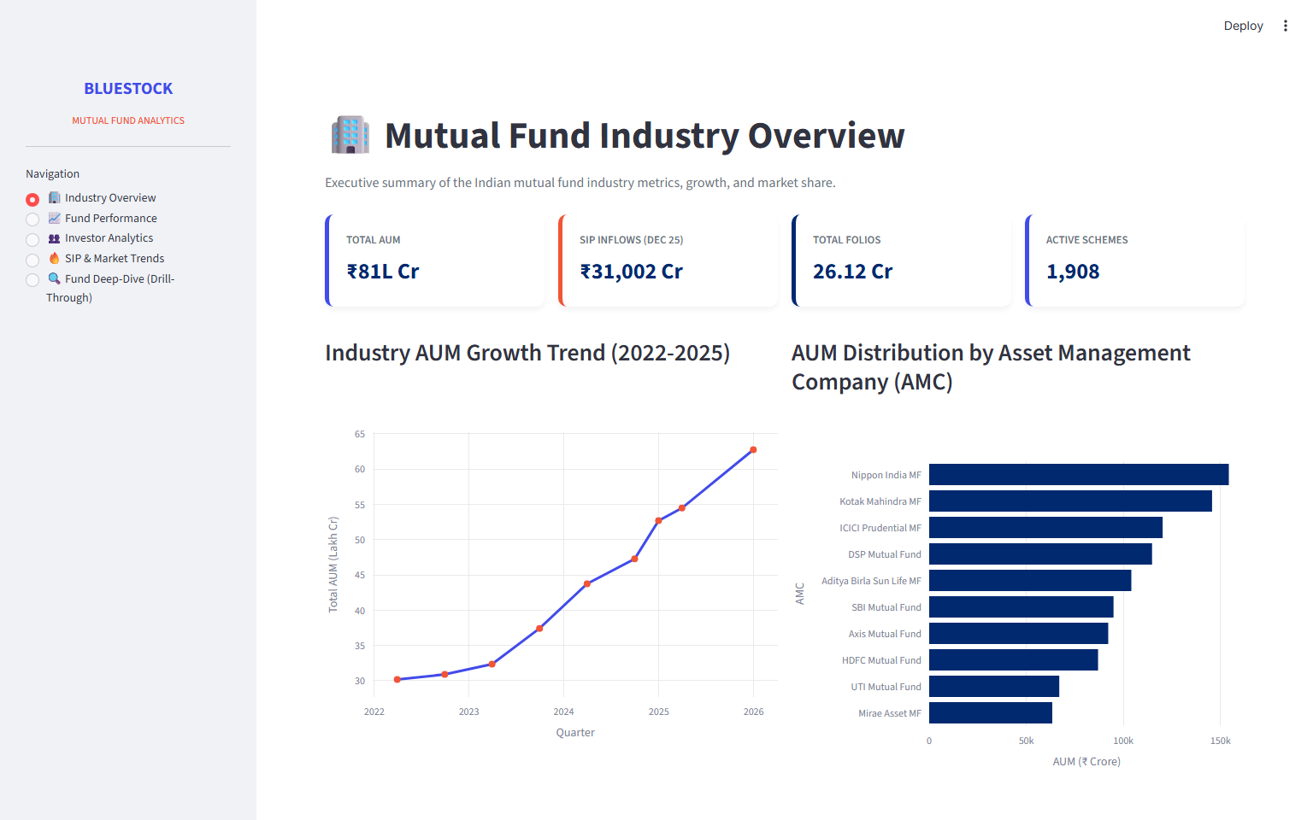
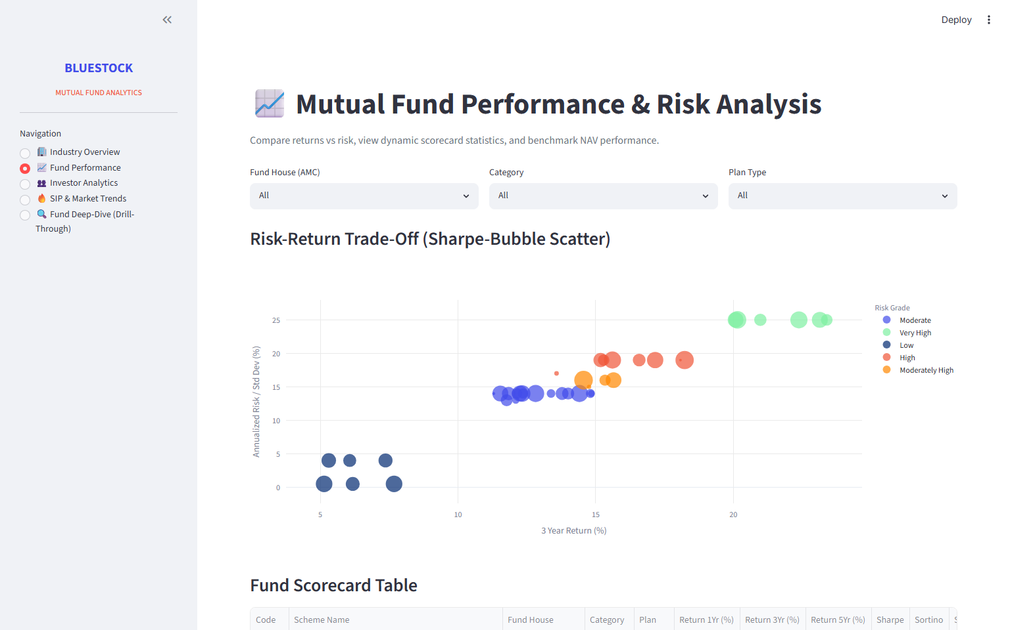
Dashboard Walkthrough I: Industry Overview & Performance
<b>Page 1: Industry Overview</b>
KPIs: Total AUM, monthly SIP inflows, and folio counts. Line charts show industry growth.
<b>Page 2: Fund Performance</b>
Scatter plot of Risk vs Return, and interactive filters for AMC, category, and plan.

Slide 10
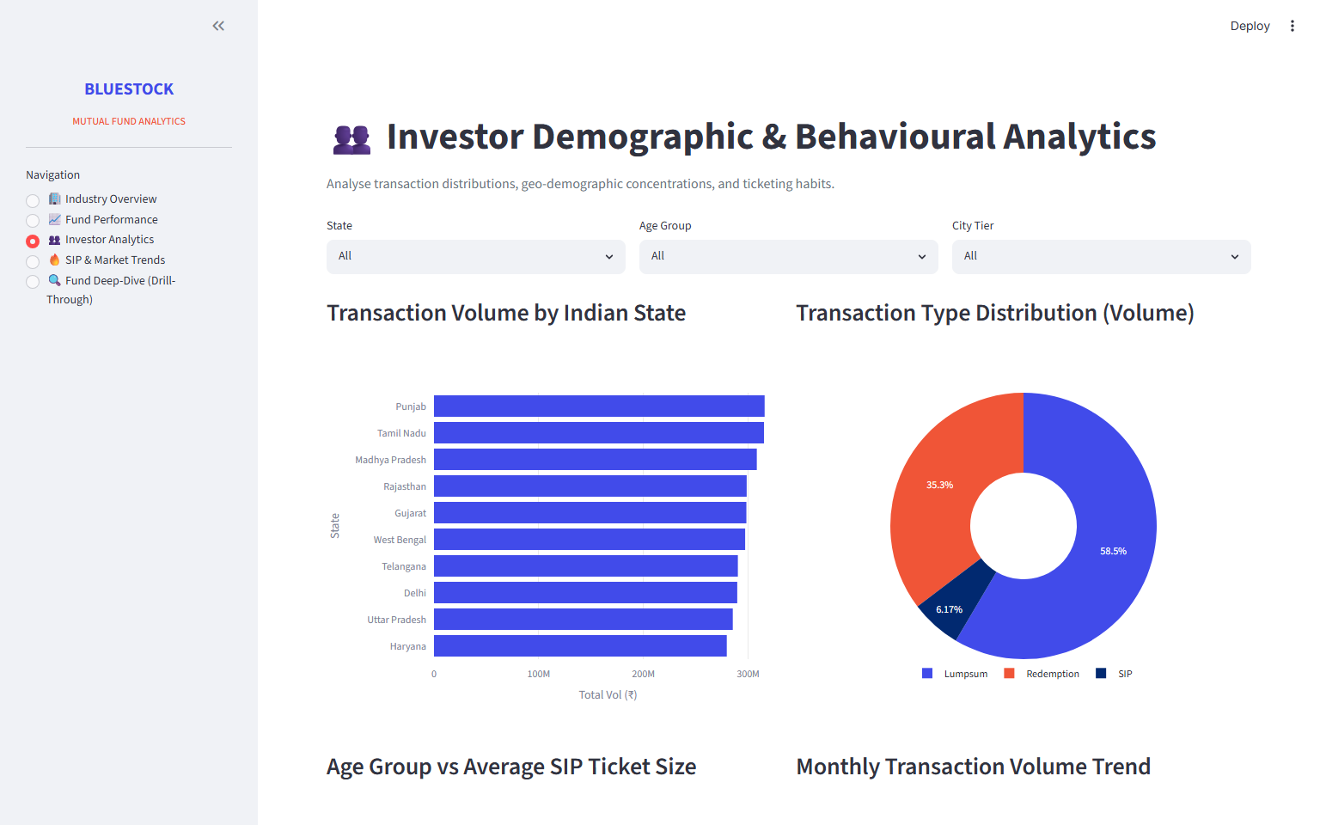
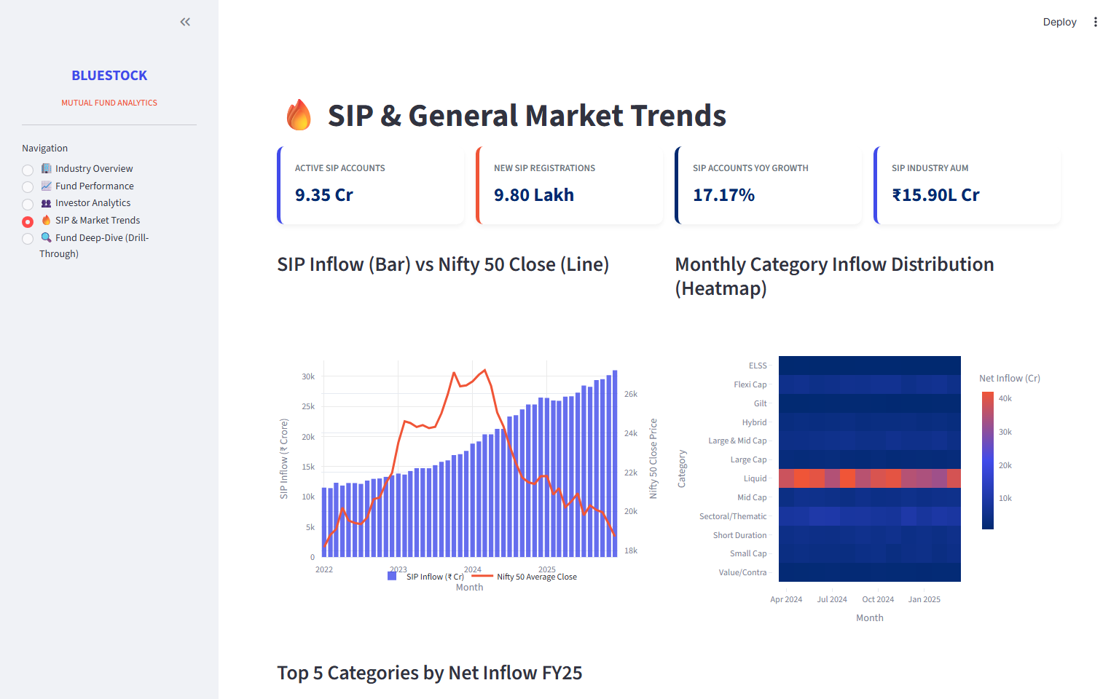
Dashboard Walkthrough II: Investor Analytics & Trends
<b>Page 3: Investor Analytics</b>
Geographic bar charts showing transaction volumes by state, product split (SIP vs Lumpsum), and age distributions.
<b>Page 4: SIP & Market Trends</b>
Visualizes the relationship between SIP inflows and Nifty 50 index levels, and category flow heatmaps.

Slide 11
Key Business Findings & Operational Recommendations
<b>Core Strategic Takeaways:</b>
• <b>SIP Continuity Risk:</b> ~97.8% of investors have average gaps between SIP dates exceeding 35 days, indicating irregular contributions. AMCs should implement auto-pay mandates and notifications.
• <b>Sector Concentration:</b> Large-cap funds showed higher sector concentration (HHI > 2,500). Wealth managers should monitor portfolio concentration.
• <b>Emerging Cohorts:</b> Newer cohorts (2025) are committing higher monthly ticket sizes despite smaller cohort volume.
• <b>Automation:</b> Deploy the ETL pipeline as a scheduled job to automate reporting.

Slide 12
Thank You
Questions & Discussion | Bluestock Mutual Fund Analytics Platform
Website: bluestock.in Prepared for Capstone Submission, June 2026

